Slide 1




American Indian Mobile Education Resources (AIMER)
Ashley L. Julian
Physics and Astronomy Major/ NAU
Mansel Nelson: Supervisor/Mentor
Dr. Gene Hill: Mentor

Slide 2
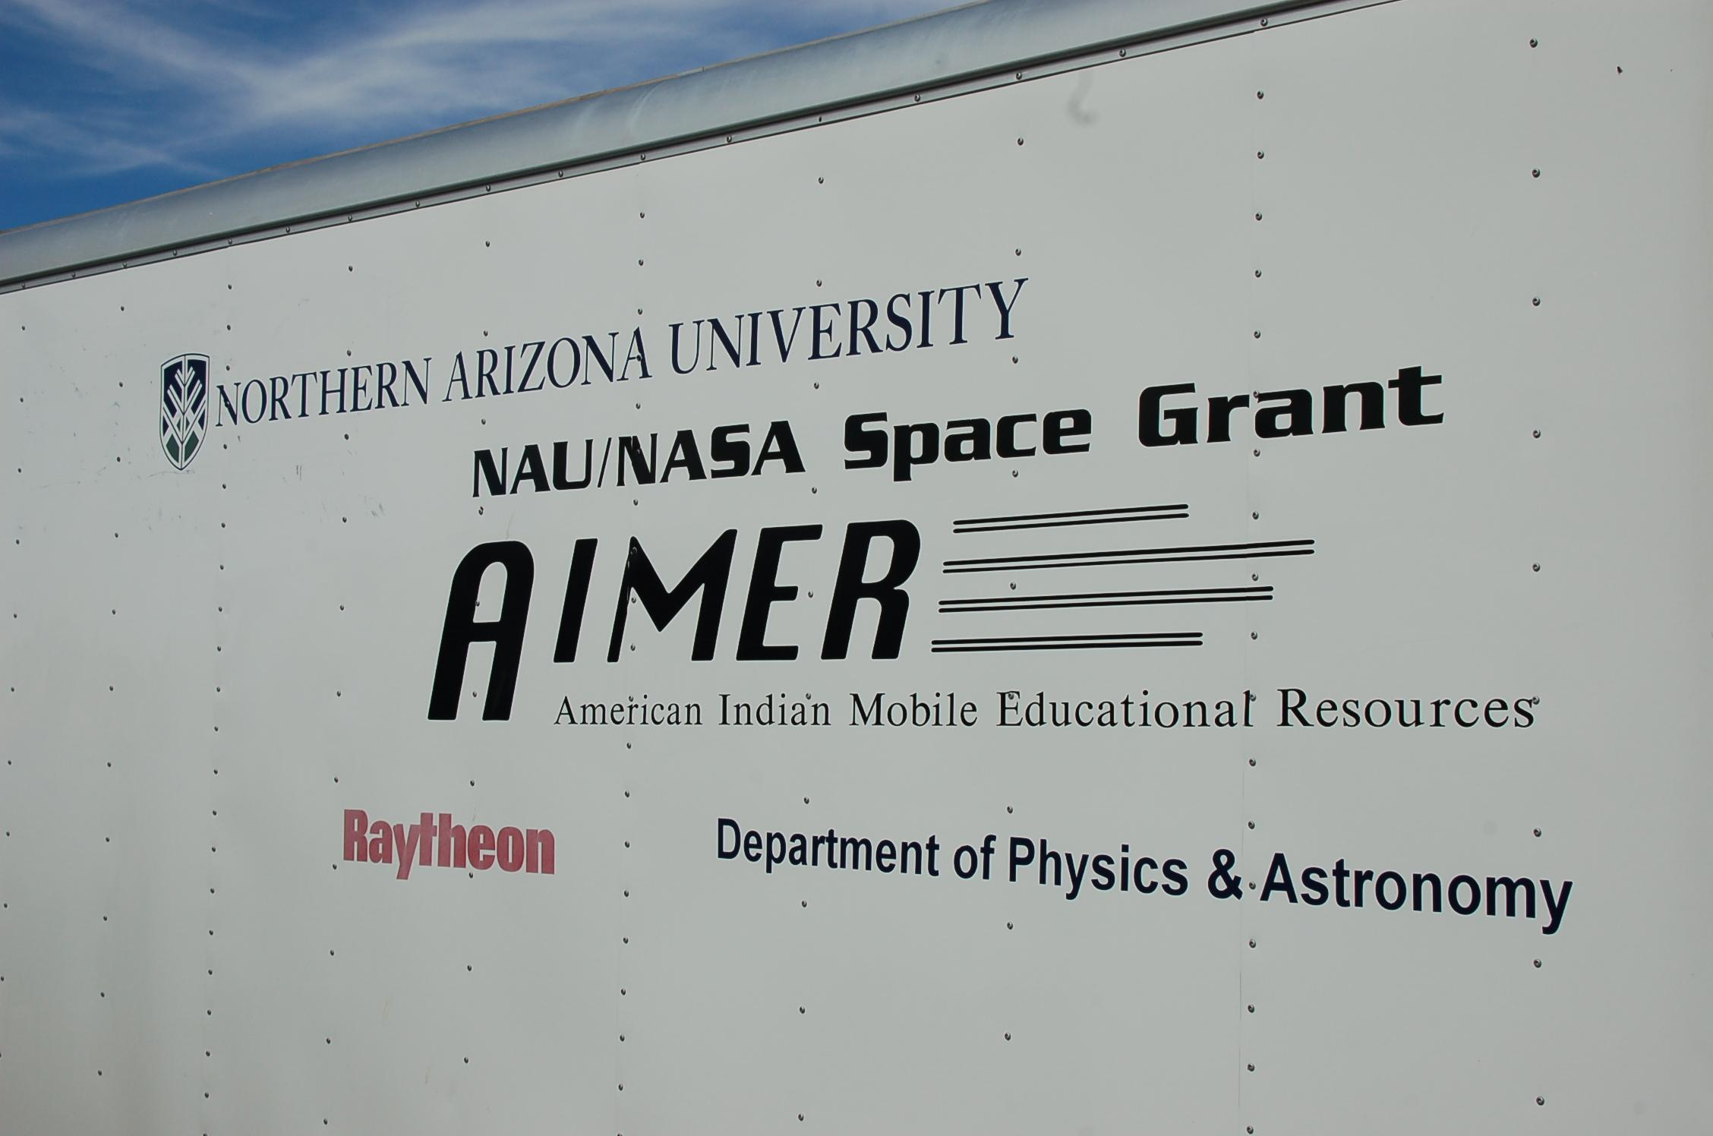
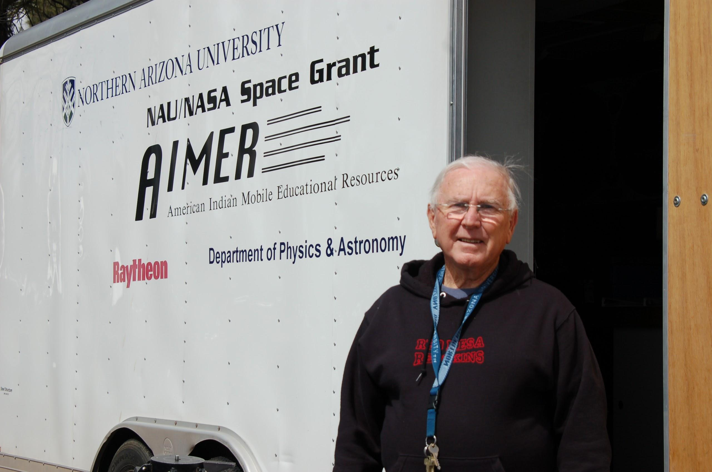
Outreach to Native Students
Mobile classroom
Computer simulation laboratory

Slide 3
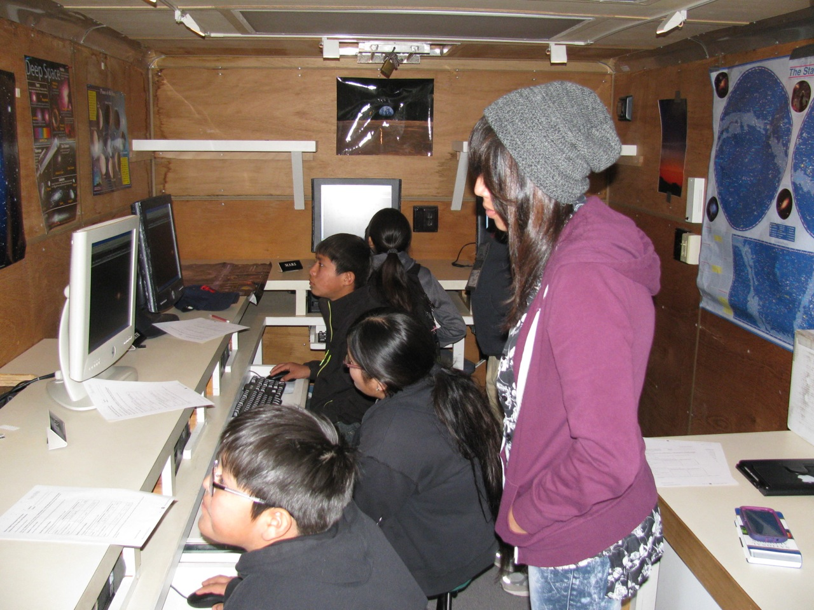
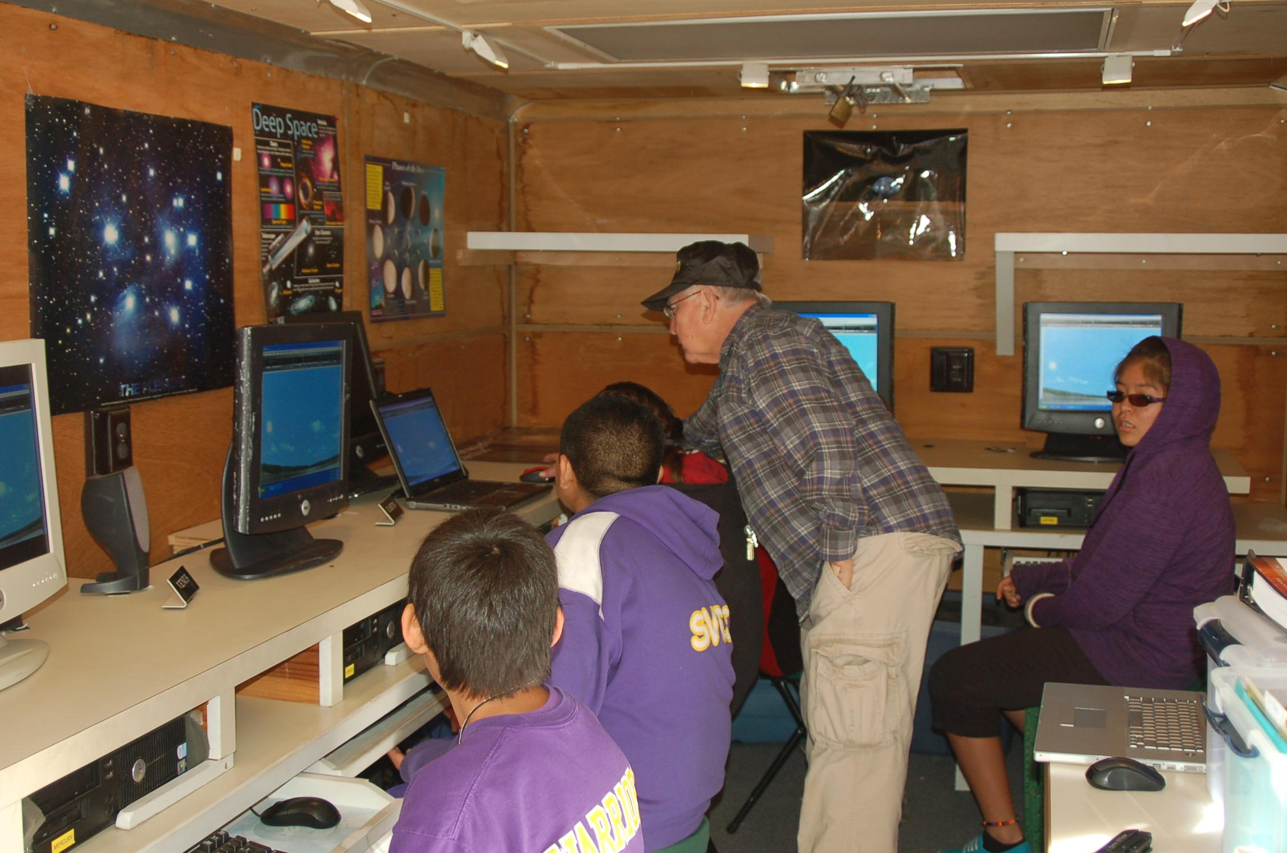
Classroom
Constellations
  Western
  Navajo
Phases of the moon
Changing of seasons
Solar System

Slide 4
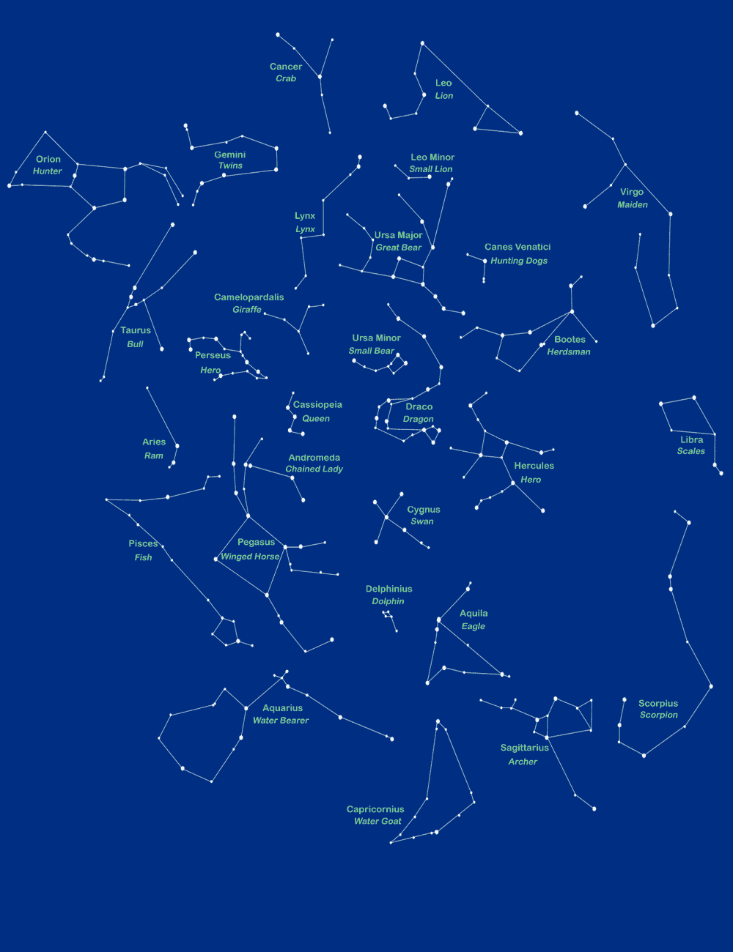
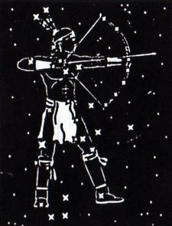
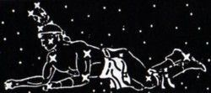
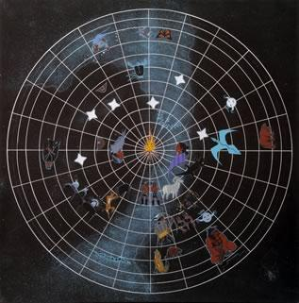
Constellations
Orion
Big Dipper
Origins
Mythology stories
spiritual meaning
Náhookos Bika'ii (Northern Male)
Átse Ats'oosí
(First Slender One)

Slide 5
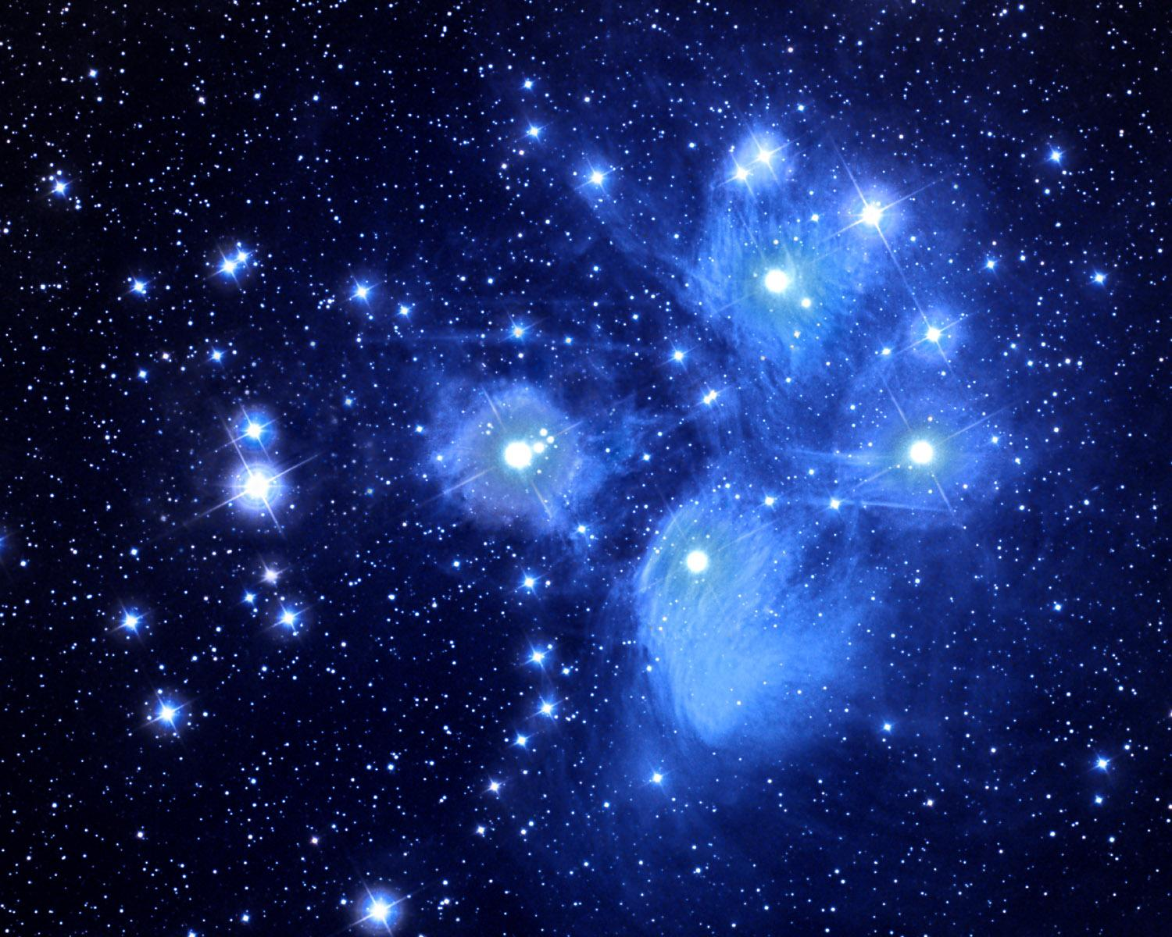
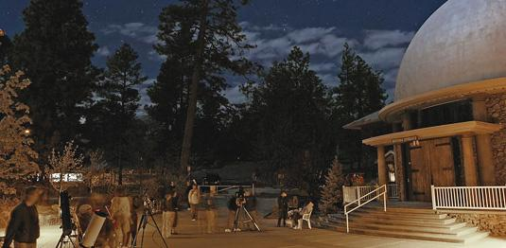
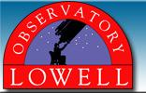
Lowell Observatory
Deep space Objects
Constellation Mythology stories

Slide 6
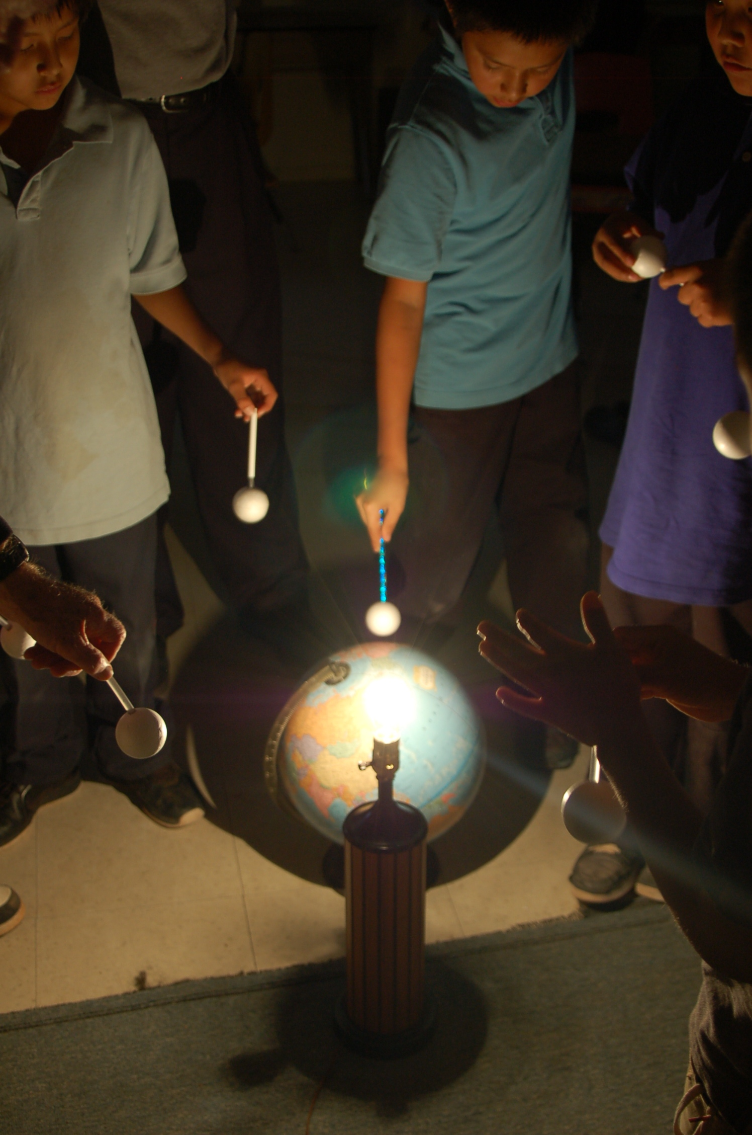
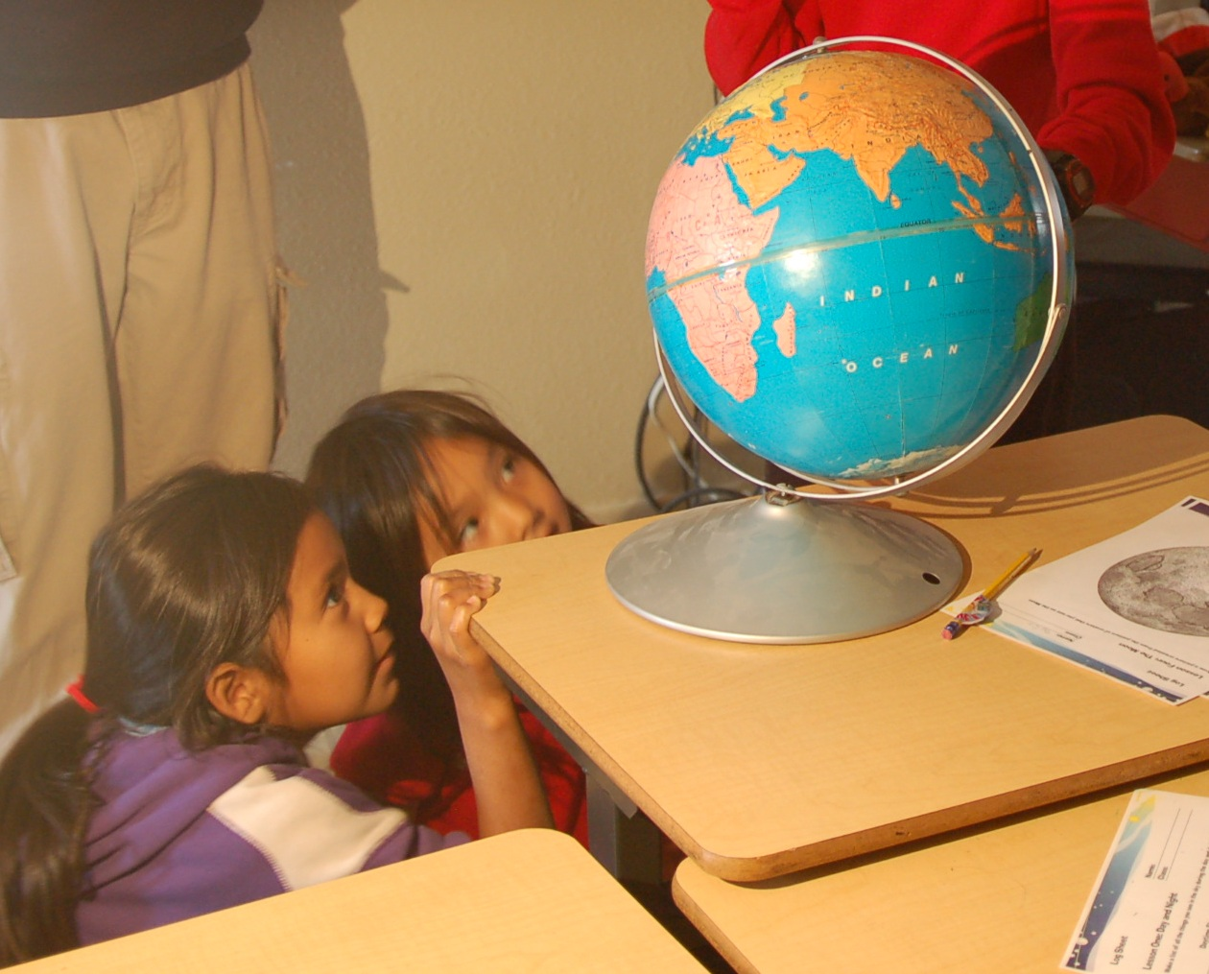
Encouragement
Wide view of science and the world
Creativity
Dream
Curiosity

Slide 7
Skills I have Learned
Patience
Clear explanations
Mythology stories
Astronomy Field
Engineering
Physics
Teacher / Mentor

Slide 8
Acknowledgements
NAU NASA Space Grant
AIMER
Lowell Observatory
Arizona Space Grant Consortium
Mansel Nelson
Dr. Gene Hill
Questions

